Slide 1



QuickServe
An On-Demand Home Services Platform
Full Stack Java Application • Spring Boot • Modular Frontend
Team Members
            Sakshi Rokade
            Sujal Pawar
            Ragavappranesh S
            Varendra Babu Koppula

Slide 2


Project Overview
The Challenge
The market for home services (plumbers, electricians, cleaners) is fragmented. Users struggle to find verified professionals, and providers lack a unified platform to manage bookings.
The Solution
QuickServe is a centralized web application that bridges this gap.
For Users: Easy booking, secure payments, and reliable service.
For Providers: Digital presence, job management, and verified income.

Slide 3
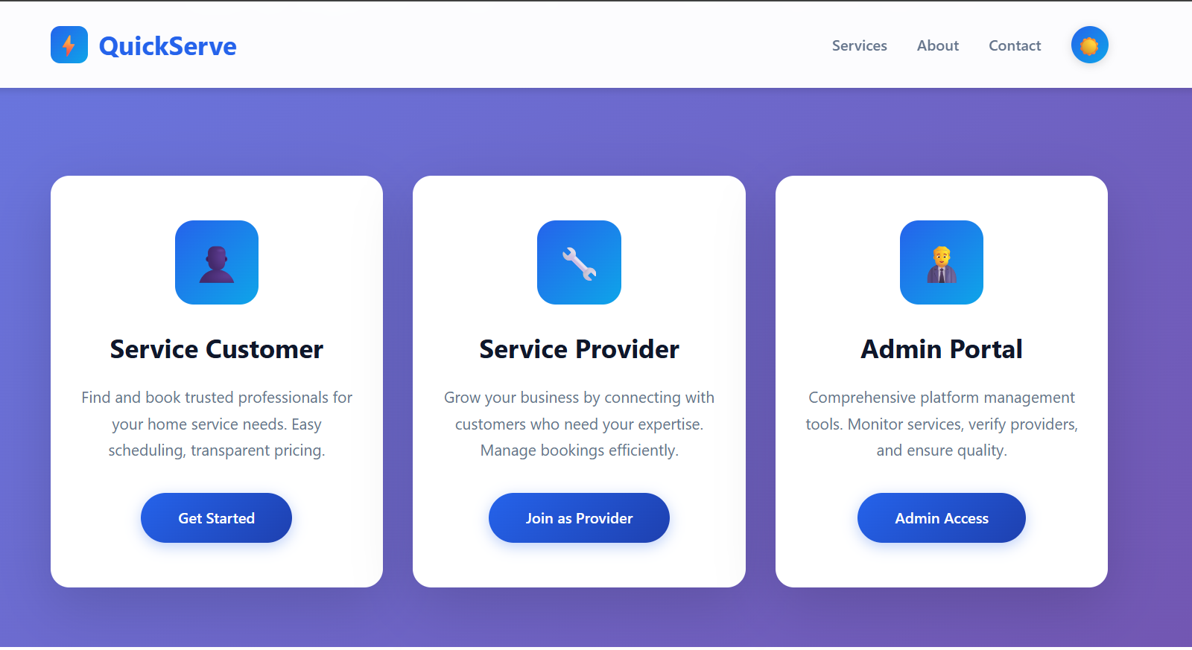

System Roles
1. The User
Can browse services, book appointments, track status via user_dashboard.html, and leave reviews.
2. The Provider
Manages availability in sp_availability.html, accepts bookings, and uploads verification documents.
3. The Admin
The controller of the platform. Verifies provider docs in admin_documents.html and oversees all bookings.

Slide 4




Technical Architecture
Backend Core
Frontend Layer
Data Persistence
Built on Java Spring Boot following the MVC pattern.
Responsive interface using HTML5, CSS3, & JavaScript.
Robust relational database architecture.
Key Controllers: AuthController, BookingController, PaymentController.
Modular JS: api.js for requests, storage.js for state, chat.js for realtime updates.
Entities: User, ServiceProvider, Booking, Review stored in quickserve.db.

Slide 5






Key Features
Wallet & Payments
Communication
Trust & Verification
Integrated digital wallet system.
Real-time interaction tools.
Safety-first approach.
•
Live Chat: User-to-/Provider messaging
•
Document upload & verification logic
•
Load money via userbookings.html
•
Chatbot: Automated support via ChatbotController
•
Secure Authentication using SecurityConfig.java
•
Transaction history logging
•
Secure endpoints in BookingController

Slide 6
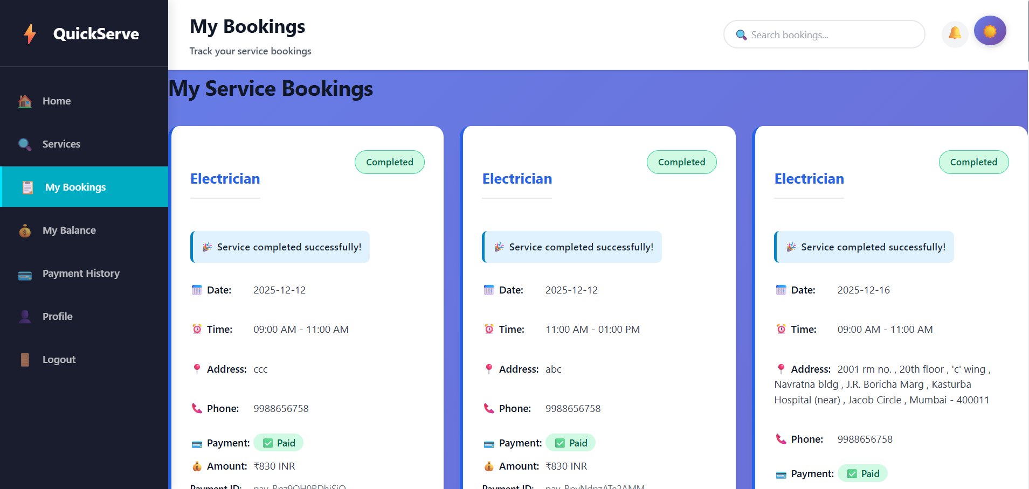
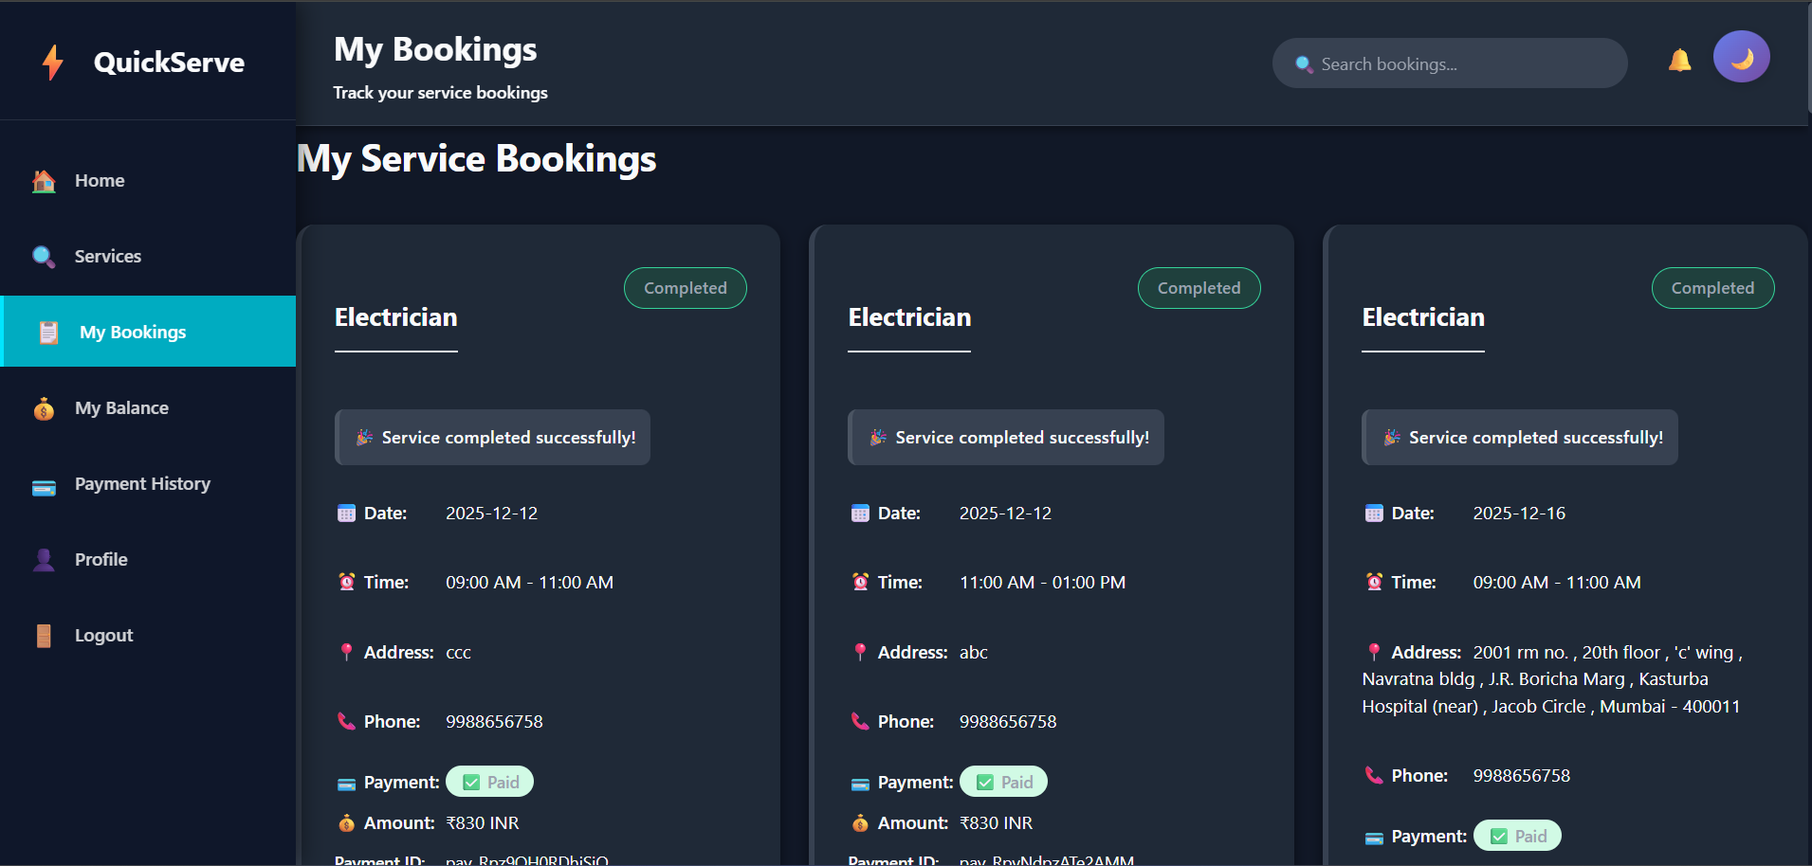
Additional Features
Beyond the core booking loop, QuickServe includes advanced modules for a better user experience.
Dark Mode: Implemented via dark-mode.js to reduce eye strain and improve battery life on mobile devices.
Smart Invoicing: Automated PDF receipt generation logic within InvoiceService.java for transparent record-keeping.
Doc Verification: A dedicated pipeline for Admin review of provider credentials via admin_documents.html.

Slide 7
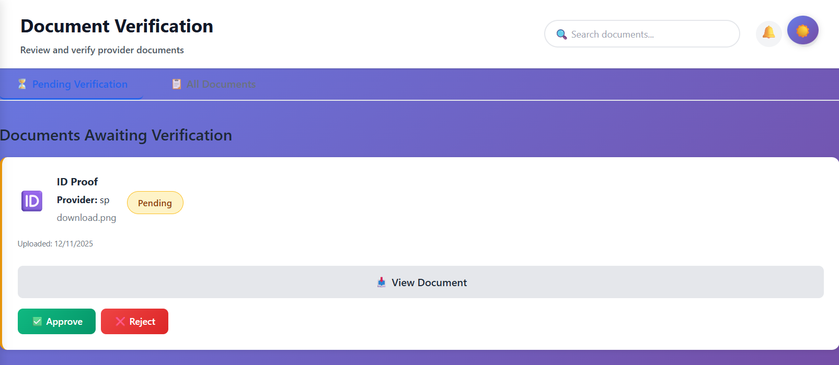
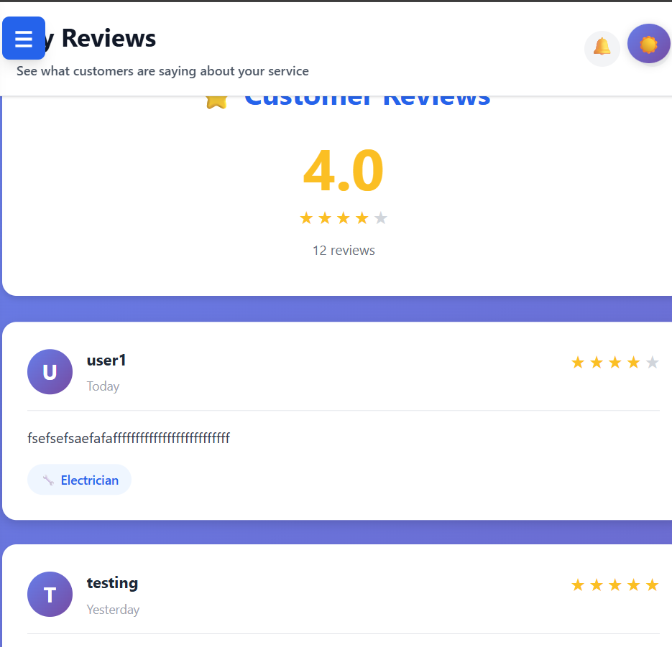
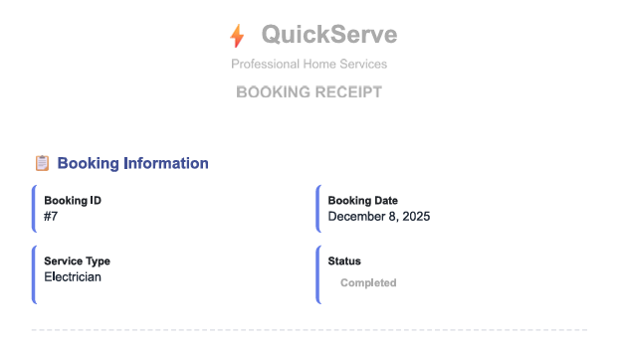



`
Output

Slide 8


Service Workflow
Signup
Browse
Book
Pay
Review
User registers & logs in via AuthController
Filter services by category (Plumber, Cleaner)
Select provider & schedule time slot
Funds deducted from Wallet balance
Rate service quality to build trust

Slide 9

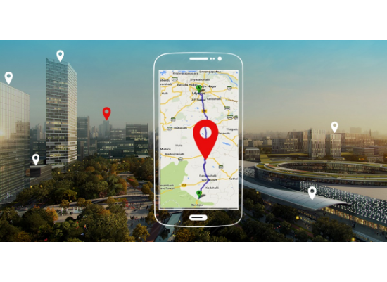
Future Capabilities
Strategic roadmap to enhance the QuickServe ecosystem.
Native Mobile Experience: Transitioning core modules to React Native for offline support and better performance.
AI Smart Matching: Implementing ML algorithms to suggest providers based on user history and job complexity.
Real-Time Geolocation: Integrating Google Maps API for live provider tracking and route optimization.
Subscription Models: Introducing "QuickServe Pro" for premium support and zero booking fees.

Slide 10
Github Link
https://github.com/SSujal-Pawarr/Java-Quickserve-Application

Slide 11



Thank You!
QuickServe demonstrates a scalable, secure, and user-friendly architecture for modern service marketplaces.
Clean Architecture
Secure Design
Future Ready

